Slide 1





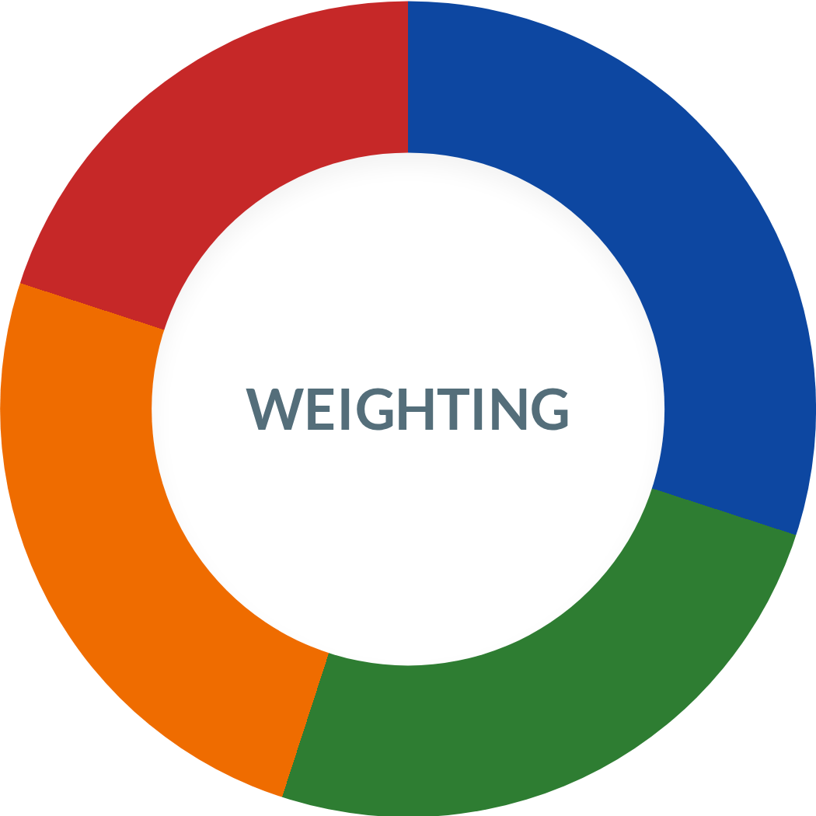










Criteria & Weighting Model
Technical Severity
Measures the inherent risk and technical depth of the vulnerability.
30%
Ease of Exploitation
Evaluates the speed with which an attacker can successfully exploit a flaw.
25%
Business Impact
Evaluates the potential damage to business effect on operations, data, network
25%
Programming Error
Author: Viktoriia Novytska (20117968)
Computer Science course
Forensics & Security Stream
Identifies the specific coding or logic failure that caused the breach.
20%

Slide 2





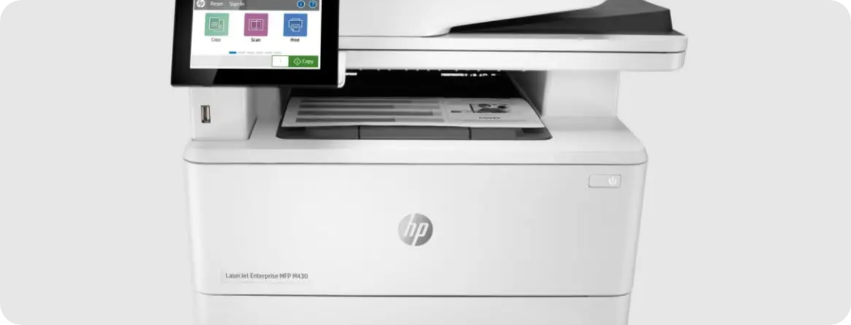

Overview of Breaches
Ivanti VPN (2023–2024)
HP LaserJet Printers (Feb 2025)
VPN software vulnerabilities (CVE-2023-46805, etc.)
Stack-based buffer overflow (CVE-2025-26506)
Remote code execution via PostScript jobs
Privilege escalation via driver issues
Affected Pro, Enterprise, Managed printers
Affected corporate networks worldwide

Slide 3
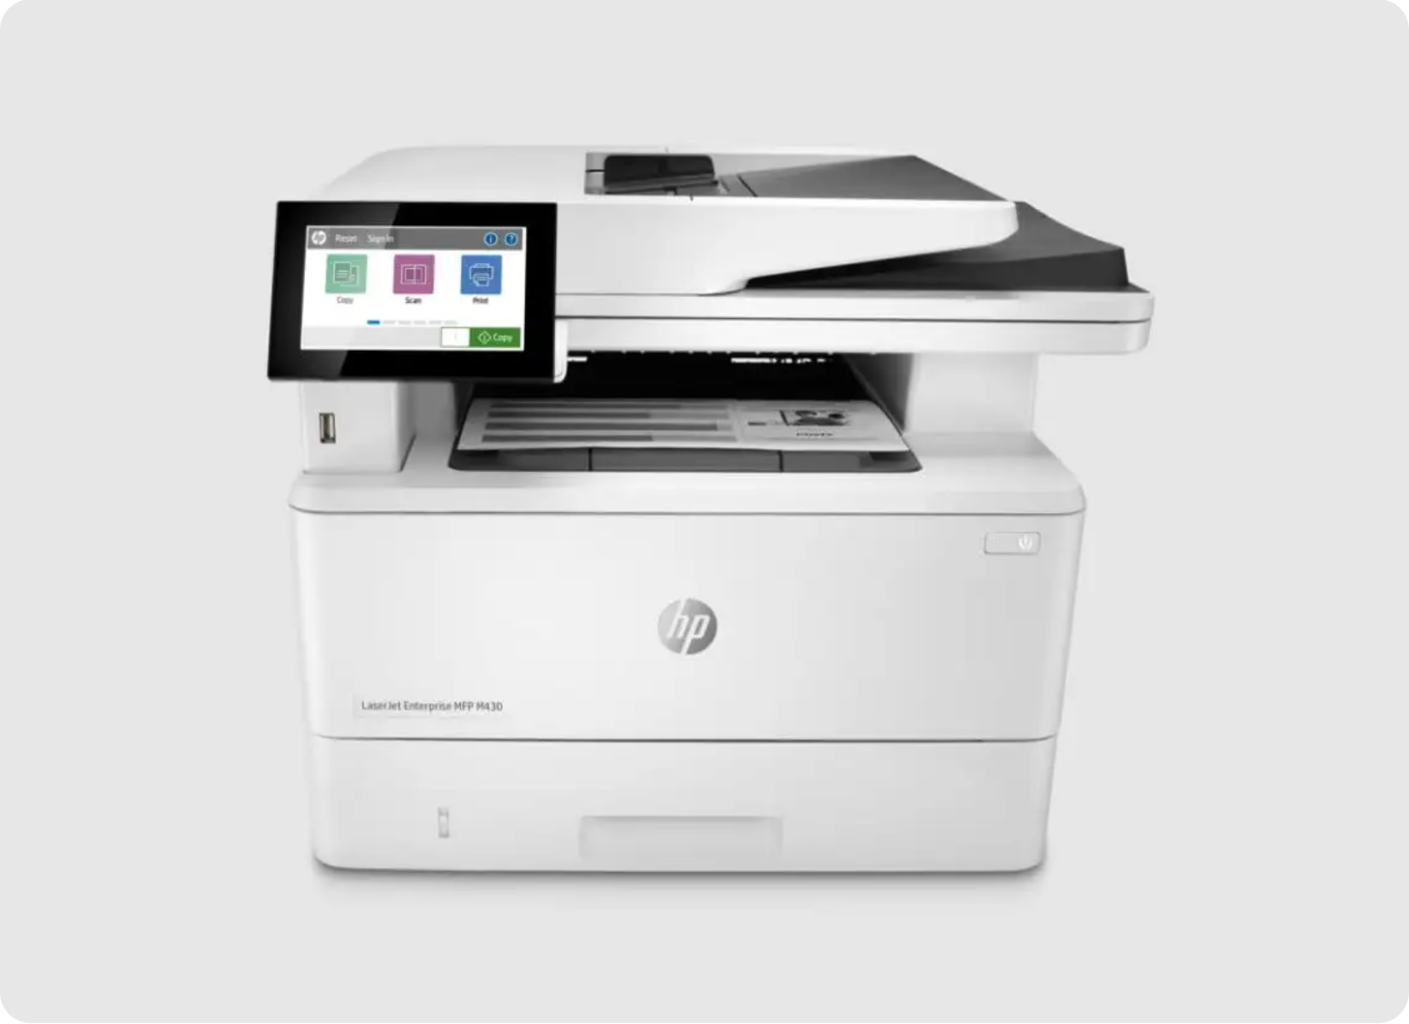
HP Printer Vulnerability – What Happened
Announced: Feb 2025 by HP (HP Security, 2025)
CVE-2025-26506: Allows remote code execution
Authentication: No authentication required
Target: LaserJet Pro, Enterprise, & Managed series

Slide 4






How the Breach Worked
Stack-based buffer overflow in PostScript processing
Firmware didn’t check input size → memory overflow
Buffer Overflow Schema
Overwrites function pointers → code execution
Buffer
OVERFLOW DATA
Exploited over network (anyone sending print job)

Slide 5

Consequences & Root Cause
Business Impact
Complete device takeover
Lost services and downtime
Leaked sensitive documents
Programming Error
Missing bounds checking
Unsafe fixed-size buffers
Poor input validation & memory management

Slide 6


Prevention & Secure Coding
Secure coding: validate inputs, avoid unsafe buffers
Regular code reviews & security testing
Timely firmware/patch updates
Network segmentation to limit damage

